Slide 1

Credit Card Approval Prediction
-Rishika Juloori

Slide 2
Background
There have been numerous changes to the way finances are being handled these days.
People are switching to more digitized versions and are embarking towards becoming cashless, preferring credit and debit cards
This puts the burden on financial institutions to provide these facilities to only legitimate people and lessen the chance of fraud.
They do this by collecting information of the appliers and processing that information to decide if their background seems legitimate

Slide 3

Question
What could be the best model to predict the approval of credit card based on the information the customer gives?

Slide 4

Aim
To find which Machine Learning model best suits the dataset provided.

Slide 5
Methodology
The project makes use of various Machine Leaning techniques and algorithms to see which one works the best for predicting whether a user could be approved for credit card
This was achieved by using various python packages.
The project analyzes all the methods and determines the best suited model for the dataset.
The following models were used:
Logistic Regression
Decision Trees
Support Vector Machine (SVM)
Perceptron Model

Slide 6
Packages used
Sklearn
Seaborn
Matplotlib
statsmodels.api
Numpy
Pandas

Slide 7
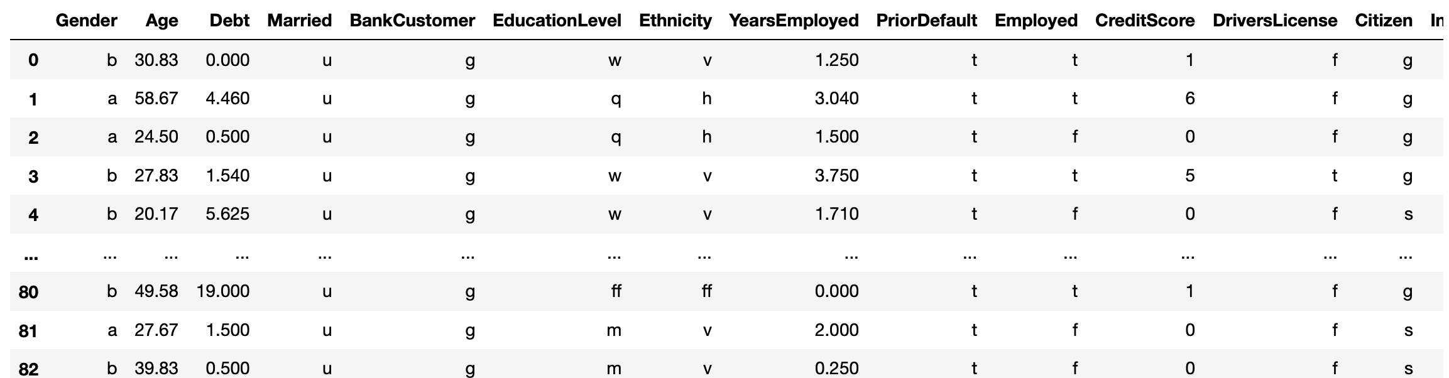
Data
The data consists of 15 columns of data and was loaded using pandas
The code also checks for missing values and imputes some of them with mean values of that column.
Some of the columns have been dropped as they were irrelevant in the approval decision.

Slide 8
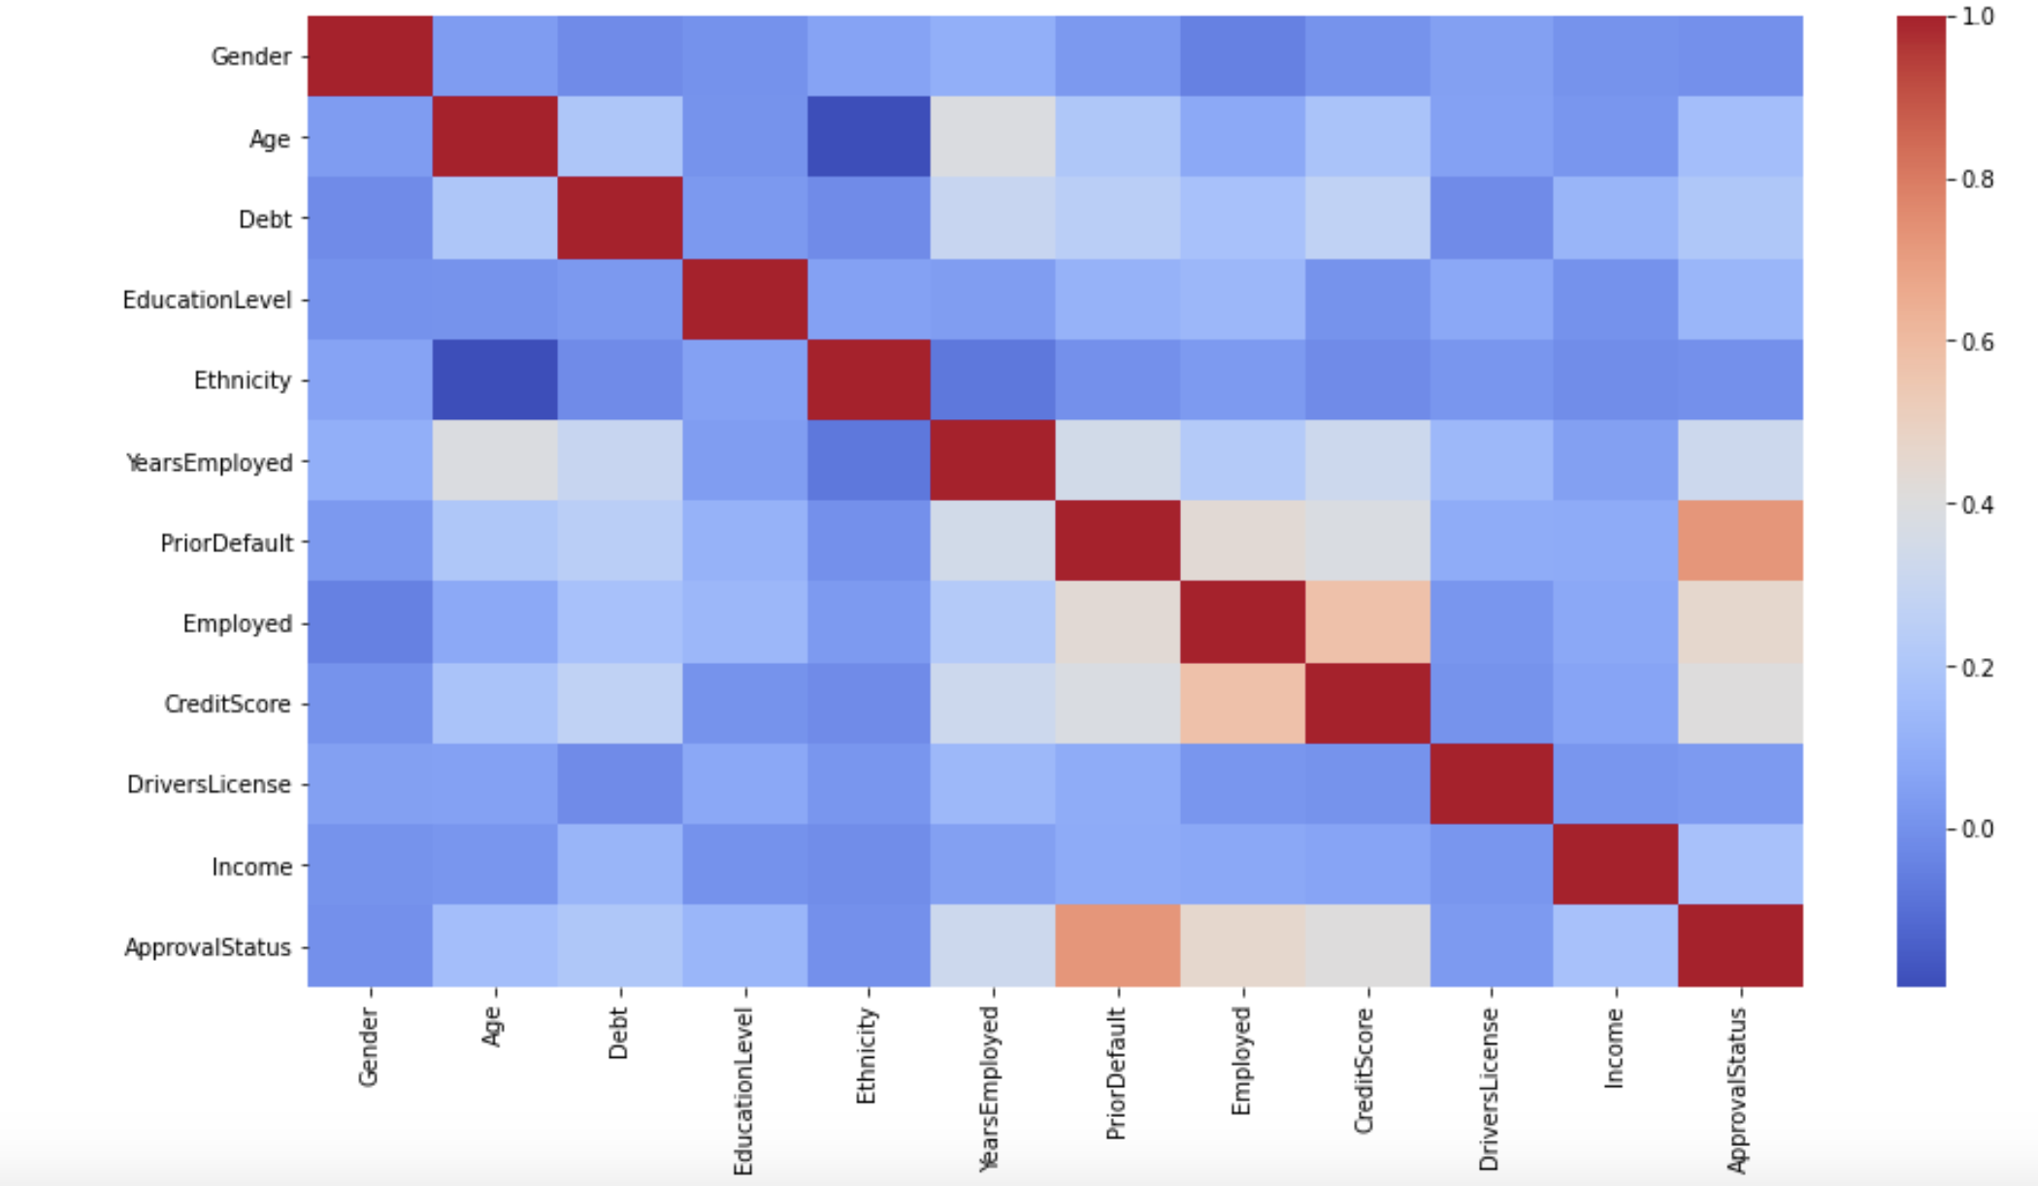
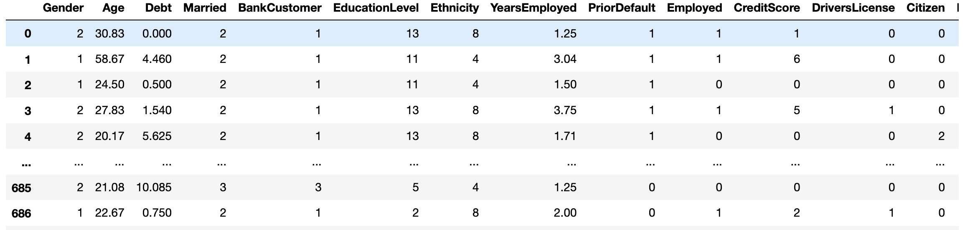
Data manipulation
Not all models take non-numeric values as input for their training. Hence a LabelEncoder function has been used to assign all the features some numeric value.
A correlation matrix has been used to see which features could be dropped to make the training easier.

Slide 9

Splitting data
Sklearn’s train_test_split has been used to break 75% of the data into training set and the other 25% into testing data.

Slide 10

Logistic Regression
This model is used to predict binary outcomes such as true or false based on the statistical analysis and observation of a data set.
The project uses statsmodels.api’s Logit model to apply a logistic regression model to the data.
The next step includes calculation of accuracy score, confusion matrix and classification report
Accuracy: 87.8%

Slide 11
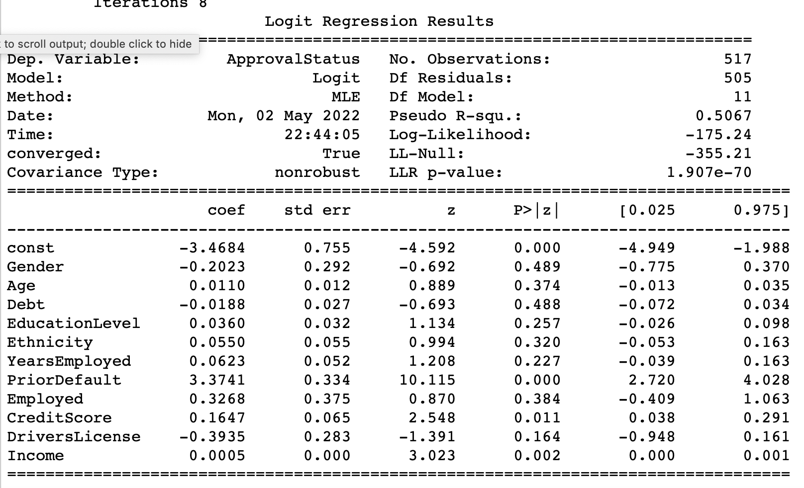
Logistic regression

Slide 12

Decision trees
It is a model which is basically a tree diagram which is used to analyze and make decisions in business or computer programming and each branch of trees represents each part of a project covering all aspects.
Three different depth parameters have been tried in the project: 3,5,15
Best depth : 5
Overfit : 15
Underfit : 3
Accuracy : 86.12%

Slide 13
Support vector machine (SVM) classifier
This model transforms your data and then it finds an optimal boundary between possible outputs based on the transformation. It is generally used for classification or regression problems.
The model has been tested with different kernel parameters and different feature vector types. (kernels = ‘linear’, ‘rbf’; feature vectors = pca transformed and regular features vector.
Accuracy: 88% with linear kernel and regular features vector

Slide 14

Perceptron
This model is a neural network unit which is used to classify data.
This model gave the least accuracy : 58%

Slide 15
Difficulties faced
Some of the models took very long to run since there are a lot of features. (For example, the SVM Model with kernel parameter as ‘rbf’ while using all the features)
Since not all models accept the features with non-numeric values, it was a little difficult to convert the features vector into numerical values. I also tried tfidf vectorization method, but only LabelEncoder worked)

Slide 16
Conclusion
The best model for this set of data which gave a good accuracy with a reasonable amount of error is the Support Vector Machine model (SVM) with a linear kernel, trained with all the feature columns (accuracy : 88%)
All the models performed pretty good except Perceptron with less than 60% accuracy.
There is a possibility to achieve more accuracy in case there is a larger dataset.

